Slide 1
Relational Algebra

Slide 2
What will you learn?
Codd’s original eight operators
closure property
semantics
what is the Algebra for?

Slide 3
1. Introduction
Relational algebra is basically just a set of operators that take relations as their operands and return a relation as their result.
Codd’s original eight operators
  The traditional set operators:
    Union（并）
    Intersection（交）
    Difference（差）
    Cartesian product（迪卡尔积）
  The special relational operators:
    restrict/select（选择）
    Project（投影）
    Join（连接）
    Divide（除）

Slide 4
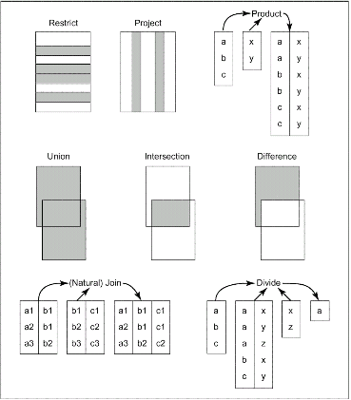
Fig. 6.1 The original eight operators (overview)

Slide 5
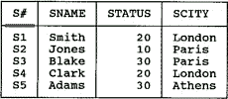
2. Closure property
Closure property:
  The output from any given relational operation is another relation.
  Nested relational expressions
RENAME operator:
  Rename attributes within a specified relation.
  e.g. S RENAME CITY AS SCITY

Slide 6
3. Semantics (关系操作的语义) -- Union
A
Two relations are type-compatible if they have the same set of attribute names which are defined on the same domains
B
The union of two (type-compatible) relations A and B:
A UNION B = {t|t∈A ∨ t∈B }
is a relation with the same heading as each of A and B and with a
body consisting of the set of all tuples t belonging to A or B or both.

Slide 7
Example of Union
Airport1
airport_name
country_name
Airport1 UNION Airport2
London/Gk
Naples
Pisa
England
Italy
Italy
airport_name
country_name
London/Gk
Naples
Pisa
London/Hw
Manchester
England
Italy
Italy
England
England
Airport2
airport_name
country_name
London/Gk
London/Hw
Manchester
England
England
England

Slide 8
3. Semantics-- Intersection
A
B
The intersection of two (type-compatible) relations A and B:
A INTERSECTION B = {t|t∈A ∧ t∈B }
- is a relation with the same heading as each of A and B and with a
body consisting of the set of all tuples t belonging to both A and B.

Slide 9
Example of Intersection
Airport1
airport_name
country_name
London/Gk
Naples
Pisa
England
Italy
Italy
Airport1 INTERSECTION Airport2
Airport2
airport_name
country_name
airport_name
country_name
London/Gk
England
London/Gk
London/Hw
Manchester
England
England
England

Slide 10
3. Semantics-- Difference
A
B
The difference of two (type-compatible) relations A and B in that order:
A MINUS B = {t|t∈A ∧ !t∈B }
- is a relation with the same heading as each of A and B and with a
body consisting of the set of all tuples t belonging to A and not to B.

Slide 11
Example of Difference
Airport1
airport_name
country_name
Airport1 MINUS Airport2
London/Gk
Naples
Pisa
England
Italy
Italy
airport_name
country_name
Naples
Pisa
Italy
Italy
Airport2
airport_name
country_name
London/Gk
London/Hw
Manchester
England
England
England
What about Airport2 MINUS Airport1?

Slide 12
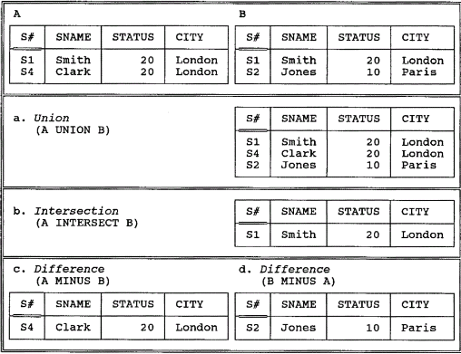
Example of Union/Intersection/Difference
Fig. 6.2 Union, intersection, and difference examples

Slide 13
3. Semantics - Product
b1
b2
a1 b1
a1 b2
a2 b1
a2 b2
a1
a2
TIMES
=
Let relations A and B have headings {X} and
{Y} respectively.
The Cartesian product of A and B where they have no common
attribute names:
A TIMES B = {ab|a∈A ∧ b∈B }
- is a relation with the heading that is the sum of the headings of A and
B and
body consisting of the set of all tuples t such that t is the
coalescing of a tuple a in A and a tuple b in B.
⌒

Slide 14
More about Product…
Semantics – Product…
The cardinality of the result of A TIMES B is the product of the cardinalities of A and B
The degree of the result is the sum of the degrees of A and B
The Cartesian product is not very important in practice
The result is often large and space-costly but produces no more information than there was in the input

Slide 15
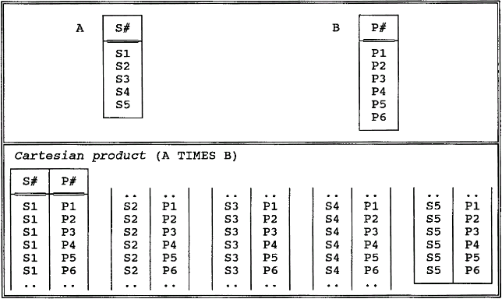
Example of Product…
    Fig. 6.3 Cartesian product example

Slide 16
3. Semantics - Restrict
A
The restriction of relation A on the condition:
A WHERE condition
is a relation with the same heading as A and with a
body consisting
of the set of all tuples t of A such that the condition is true for t

Slide 17
Restriction Condition
A WHERE X θ Y
X, Y are attributes of A, and must be defined on the same domain
θ is any simple scalar comparison operator like =, ≠, >, ≥ etc.
In fact, the restriction condition can be an arbitrary Boolean
combination of simple comparisons connected by AND, OR, NOT.
Take note: Unlike the traditional set operators, restrict takes a relation and an
expression as input, and produces a relation as output. Some concepts like
commutativity and associativity no longer applicable.

Slide 18
Example of Restrictions
Airports
Airports WHERE airport_name = ‘London/GK’
airport_name
country_name
airport_name
country_name
Naples
London/Gk
London/Hw
Pisa
Venice/MP
Manchester
Kai Tak
Changi
Italy
England
England
Italy
Italy
England
Hong Kong
Singapore
London/Gk
England
Airports WHERE country_name = ‘England’
airport_name
country_name
London/Gk
London/Hw
Manchester
England
England
England

Slide 19
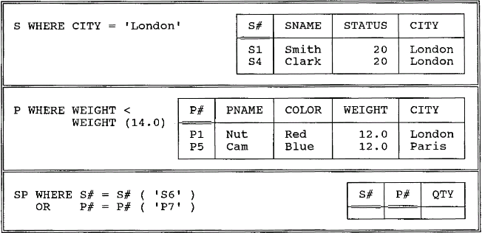
Example of Restrictions
Fig. 6.4 Restriction examples

Slide 20
3. Semantics - Project
A
The projection of relation A on attributes X, Y, …, Z:
A {X, Y, …, Z}
- is a relation with the heading {X, Y, …, Z} and with the a body
consisting of the set of all tuples {X:x, Y:y, …, Z:z} such that a
tuple appears in A with X-value x, Y-value y, …, Z-value z.

Slide 21
More about Projection
The projection operator produces the output table by 1) eliminating
all attributes not specified, and 2) eliminating any duplicated
tuples
A -- identity projection
A{} -- nullary projection (both not very useful but legal)
We may project some attributes away instead of the standard way
This operator can be used to 1) rename attributes, and 2) permute attributes

Slide 22
Example of Projections
Airports
Airports {country_name, airport_name}
airport_name
country_name
country_name
airport_name
Naples
London/Gk
London/Hw
Pisa
Venice/MP
Manchester
Kai Tak
Changi
Italy
England
England
Italy
Italy
England
Hong Kong
Singapore
England
London/Gk
… …
… …
Airports {country_name} a unary relation
country_name
(We could rename the attribute
at the same time using the below
expression:
Airport [RENAME country-name
AS country]
)
Italy
England
Hong Kong
Singapore

Slide 23
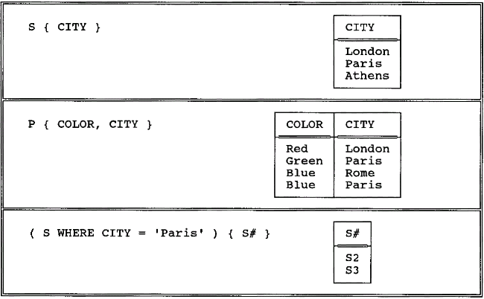
Example of project
Fig. 6.5 Projection examples

Slide 24
3. Semantics - Natural Join
b1 c1
b1 c2
a1 b1 c1
a1 b1 c2
a2 b1 c1
a2 b1 c2
a1 b1
a2 b1
join
=
Let relations A and B have headings {X, Y} and
{Y, Z} (where X, Y and Z are composite attributes).
The (natural) join of A and B: A JOIN B
- is a relation with the heading {X, Y, Z} and body consisting of the
set of all tuples {X:x, Y:y, Z:z} such that a tuple appears in A with
X-value x and Y-value y and a tuple appears in B with Y-value y and
Z-value z.

Slide 25
More about Natural Join
A JOIN B JOIN C = (A JOIN B) JOIN C
= A JOIN (B JOIN C) (associative)
A JOIN B = B JOIN A (commutative)
If A and B have no attribute names in common, A JOIN B = ?
= A TIMES B

Slide 26
Example of Natural Join
Airports
Stops
airport_name
country_name
flight_number
airport_name
stop_number
Naples
London/Gk
London/Hw
Pisa
Venice/MP
Manchester
Kai Tak
Changi
Italy
England
England
Italy
Italy
England
Hong Kong
Singapore
BA383
Kai Tak
1
BA019
Changi
2
Stops JOIN Airports
flight_number airport_name stop_number country_name
BA383 Kai Tak 1 Hong Kong
BA019 Changi 2 Singapore

Slide 27
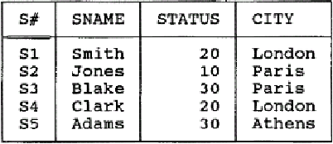
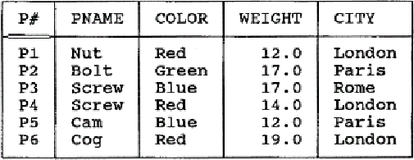
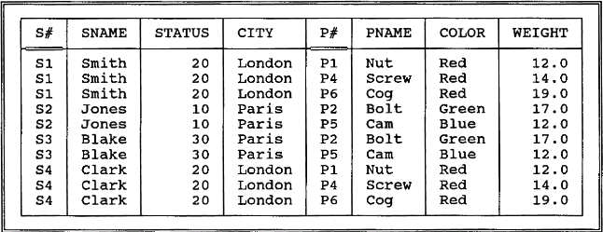
Example of Natural Join
S
P
Fig. 6.6 The natural join S JOIN P

Slide 28
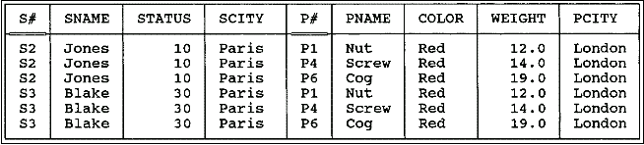
3. Semantics –θ-Join(θ连接）
A TIMES B WHERE RθS
e.g.
((S RENAME CITY AS SCITY) TIMES
(P RENAME CITY AS PCITY))
WHERE SCITY>PCITY
Fig. 6.7 Greater-than join of suppliers and parts on cities

Slide 29
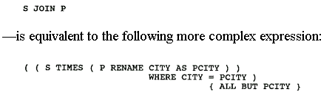
3. Semantics –equijoin(等值连接）
If θ is "=", the θ-join is called an equijoin.

Slide 30
3. Semantics –Divide
a x
a y
a z
b x
c y
=
a
b
c
divided by
x
y
per
a
The division of A by B per C:
A DIVIDEBY B PER C
Let relations A , B and C have headings
{X},{Y}, and {X, Y}
(where X and Y are composite attributes).
is a relation with the heading {X} and
body consisting of all tuples {X:x} such that a tuple {X:x, Y:y} appears in C for all tuples
{Y:y} appearing in B.

Slide 31
Example of Division
Suppose that we wish to know airports to which we
can fly from both London/Gk and London/Hw
Airports
destination
Airport_London
destination
origin
Destin
London/Gk
Pisa
Manchester
Kai Tak
London/Hw
DIVIDEBY
origin
London/Gk
Pisa
Pisa
London/Gk
Manchester
Kai Tak
Manchester
London/Hw
Naples
London/Gk
London/Hw
Pisa
Venice/MP
Manchester
Kai Tak
Changi
destination
PER
=
London/Gk
Pisa
London/Hw
‘Both’ , ‘All’ etc. hint the division operator:
ex. Get suppliers who supply all parts

Slide 32
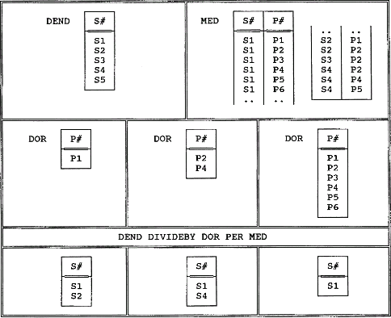
Example of Division
A DIVIDEBY B PER C
Fig. 6.8 Division examples

Slide 33
3. Semantics – Associativity and Commutativity
结合律和交换律
A UNION B UNION C = (A UNION B) UNION C
= A UNION (B UNION C) (associative)
(Applicable to INTERSECT and TIMES but not to MINUS)
A UNION B = B UNION A (commutative)
(Applicable to INTERSECT and TIMES but not to MINUS)
Note that the Cartesian product operation of set theory is neither associative nor commutative, but the relational version as we have defined it IS both.

Slide 34
Note:
Some of Codd eight operators are not primitive
{restrict, project, product, union, difference}-→minimal set

Slide 35
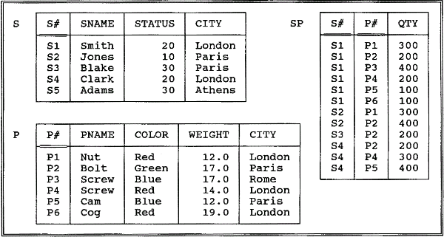
4. Examples
Fig. 3.8. The Suppliers and parts database(sample values)
P111

Slide 36
4. Examples
Get supplier names for suppliers who supply part P2.
Get supplier names for suppliers who supply at least one red part.

Slide 37

4. Examples…
Get supplier names for suppliers who supply all parts.
Get supplier numbers for suppliers who supply at least all those parts supplied by supplier S2.
Get all pairs of supplier numbers such that the two suppliers concerned are "colocated" (i.e., located in the same city).

Slide 38
4. Examples…
Get supplier names for suppliers who do not supply part P2.

Slide 39
5. What is the Algebra for?
The fundamental intent of the algebra is to allow the writing of the relational expressions.
Defining a scope for retrieval
Defining a scope for update
Defining integrity constraint
Defining derived relvars
Defining stability requirements
Defining security constraints

Slide 40
5. What is the Algebra for?...
serve as a convenient basis for optimization
the expressions serving as a high-level, symbolic representation of the user’s intent, can be transformed into the logically equivalent.
((SP JOIN S ) WHERE P#=P#(‘P2’)){SNAME}
=
((SP WHERE P#=P#(‘P2’) JOIN S ){SNAME}
yardstick to measure the expressive power of some given language.
relational complete

Slide 41
关系运算有助于查询优化
通过对关系代数表达式的等价交换，减少多次扫描和读取文件以节省运行时间
尽可能早的执行选择运算，以期得到较少的中间结果
用连接运算代替乘积再选择运算
一连串的选择和一连串的投影同时运算，分开会多次扫描文件
预先计算并保存多次出现的子表达式结果
建立索引，提高关系连接的速度

Slide 42
课堂练习
Student
学号 | 姓名 | 性别 | 年龄 | 系
00301 00302 00303 00304 | 李勇 刘晨 王明 张力 | 男 女 女 男 | 20 19 18 19 | CS IS MA IS
Course
课程号 | 课程名 | 先行课 | 学分
1 2 3 4 5 6 7 | 数据库 数学 信息系统 操作系统 数据结构 数据处理 C语言 | 5 1 6 7 6 | 4 2 4 3 4 2 1
SC
学号 | 课程号 | 成绩
00301 00301 00301 00302 00302 | 1 2 3 2 3 | 92 85 88 90 80

Slide 43
课堂练习
求解：
1. 所有学生的姓名、性别；
2. 信息系学生的姓名、性别；
3. 选修了“数学”课的学生姓名、性别；
4. 同时选修了“数学”和“信息系统”课的学生姓名；
5. 至少选修了课程1、3的学生学号；
6. 上例中的学生学号、姓名、系；
7. 选修了课程2的学生学号；
8. 至少选修了一门其直接先行课为6的课程的学生姓名；
9. 选修了全部先行课为6的课程的学生姓名；
10. 选修了“刘晨”所选全部课程的学生姓名；
11. 年龄最大(or 成绩最高)的学生姓名；
12. 与“刘晨”同系的学生姓名；
13. 同系学生对。

Slide 44
关系运算（拓展）
关系模型与关系运算密切相关，关系运算理论是关系数据库技术的基础。
关系运算包括关系代数和关系演算。关系代数是以关系为运算对象的一组高级运算的集合；关系演算基于数理逻辑谓词演算。
关系操作包括查询、插入、删除和修改，它们的数学基础是关系代数，关系代数又以集合理论为基础。
关系代数分为：五种基本运算并、差、乘积、选择、投影构成完备运算集，其他非基本运算可用五种基本运算合成。

Slide 45
1、关系代数
关系代数：
设关系R和S的目（属性或分量数目）分别为r和s，t为元组变量。
1）并union运算：关系R和S相容（具有相同的关系模式，目及值域相同），两者并是由属于R和S的元组构成的集合：
R∪S={t|t∈R∨t∈S}
注意：两个相容关系的列数相同，对应列同质；合并结果中若含有重复的元组，必须除掉多余的元组。

Slide 46
2）差difference运算：关系R和S相容，两者差是由属于R但不属于S的元组构成的集合：
R-S={t|t∈R∧t∈S}
3）乘积product运算：R为r元（目）关系，S为s元关系，两者乘积是一个(r+s)元的元组集合：
RXS={t|t=<t_{r}, t_{s}> ∧ t_{r} ∈R ∧ t_{s}∈S}
积的每个元组<t_{r}, t_{s}> 均由原来的两个元组组成，前r个分量来自R，后s个分量来自S。

Slide 47
积的算法：用R的第i个元组分别与S的全部元组连接而成积的元组，因此乘积的基即元组个数等于R的基和S的基的乘积。
R和S有相同属性时，乘积的属性名不能相同，则用“R.属性名”和“S.属性名”以示区别。
4）选择运算：对关系进行水平分割，即从原关系中选取符合给定条件的那些元组：
σ_{F}(R)=={t|t∈R∧F(t)=true}, F为逻辑表达式。
Select ALL from R where F
F包含两种成分：运算对象如常数、元组分量；运算符如算术比较运算符、逻辑运算符。

Slide 48
5）投影运算：对关系进行垂直分割，即从原关系中取出某些列并重新排序：
π_{A}(R)= {t [A] | t∈R}, A为R中的属性列。
Select A from R
投影结果往往含有重复的元组，必须除掉多余的。
6）交运算：关系R和S相容，两者交是由属于R且属于S的元组构成的集合：
R∩S= ={t|t∈R∧t∈S}。

Slide 49
7）连接：从两个关系模式中选取属性间满足一定条件的元组。
R S={t |t= <t_{r}, t_{s}> ∧ t_{r}∈R ∧ t_{s} ∈S ∧t_{r} [A]θt_{s} [B]}
A和B分别为R和S上可比较的分量或属性（组）， θ为比较运算符。
用R的第i个元组的A分量依次与S的每个元组的B分量进行θ比较，若满足则把S的那个元组接在R的第i个元组之后，作为连接关系的一个元组。
连接运算是在乘积运算的基础上增加了比较条件。
乘积运算在时间空间上开销大，优化连接可减少。

Slide 50
等值连接是θ为“=”的连接，它是从R和S的乘积中选取A和B属性值相等的那些元组。
R S={t |t= <t_{r}, t_{s}> ∧ t_{r}∈R∧t_{s} ∈S ∧t_{r} [A]=t_{s}[B]}
自然连接运算：两个关系具有一个以上的公共属性（组）A，公共属性相等时连接对应元组构成一个新元组，从连接结果中除掉重复的属性列。
R S={t |t= <t_{r}, t_{s}> ∧ t_{r}∈R∧t_{s} ∈S ∧t_{r} [A]=t_{s}[A]}
自然连接是一种特殊的等值连接。

Slide 51
8）除法运算：关系R（X，Y），关系S（Y，Z），其中X，Y，Z为属性组，R的Y和S的Y属性名可以不同，但必须出自相同的域集，则R/S=关系P（X）。
9）外连接运算：连接运算中如果把舍弃的元组也保存在结果中，无值的属性上填空值（NULL）。左外连接和右外连接。
10）外部并运算：关系R和S不相容，外部并是由R或S的所有属性组成，没有具体值的属性为NULL。

Slide 52
2、关系演算
关系演算是以数理逻辑的谓词演算为基础，分为元组关系演算和域关系演算。
命题逻辑：能够用于判断的陈述句被称为命题。命题逻辑包含原子命题、用联结词及括号构成的分子命题，命题公式和函数，以及等价、蕴含、推理理论。
对原子命题的进一步解析产生了谓词逻辑。
谓词演算：原子命题是由一个谓词及若干个体两部分组成的，称为谓词命题。引入量词（全称和存在）的命题公式称为谓词命题公式，包含等价、蕴含、推理理论。

Slide 53
1）元组关系演算
形式化表达：{t | P (t) }，t是元组变量，P是条件表达式，其结果是一个满足公式P的所有元组t的集合或关系。
演算公式同谓词逻辑。
谓词运算符：∃-存在，∀-所有，┐-非，∧-与，∨-或，→-如果…那么…
元组关系演算语言ALPHA。

Slide 54
2）域关系演算
类似于元组关系演算，但变量不是元组而是元组中各个分量的域变量。
形式化表达：{<t₁, t₂, …, t_{k}>| P (t₁, t₂, …, t_{k}) }， t₁, t₂, …, t_{k}是元组变量t的各个分量。
域关系演算语言QBE。
元组演算表达式与域演算表达式可相互转换。
SQL语言建立在关系代数和关系演算的数学基础上

